Slide 1
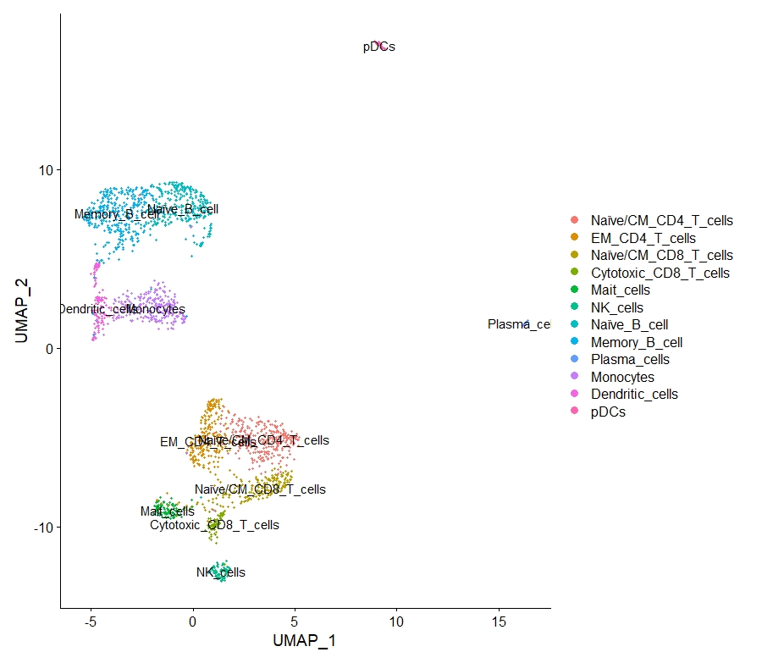
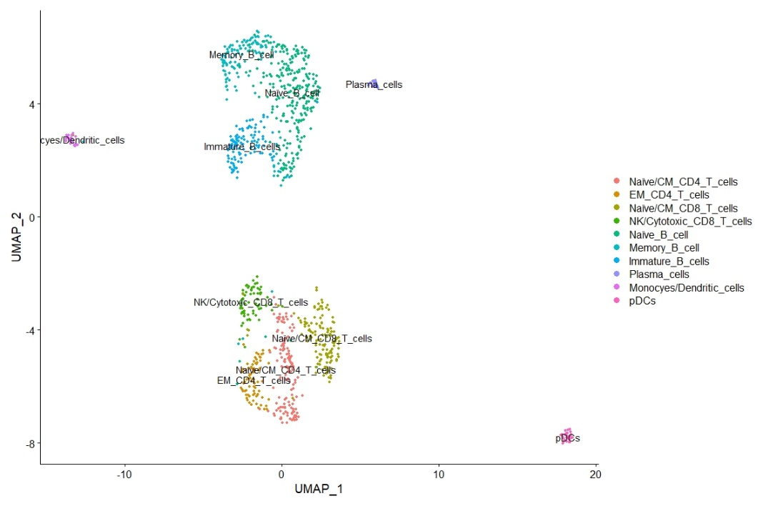
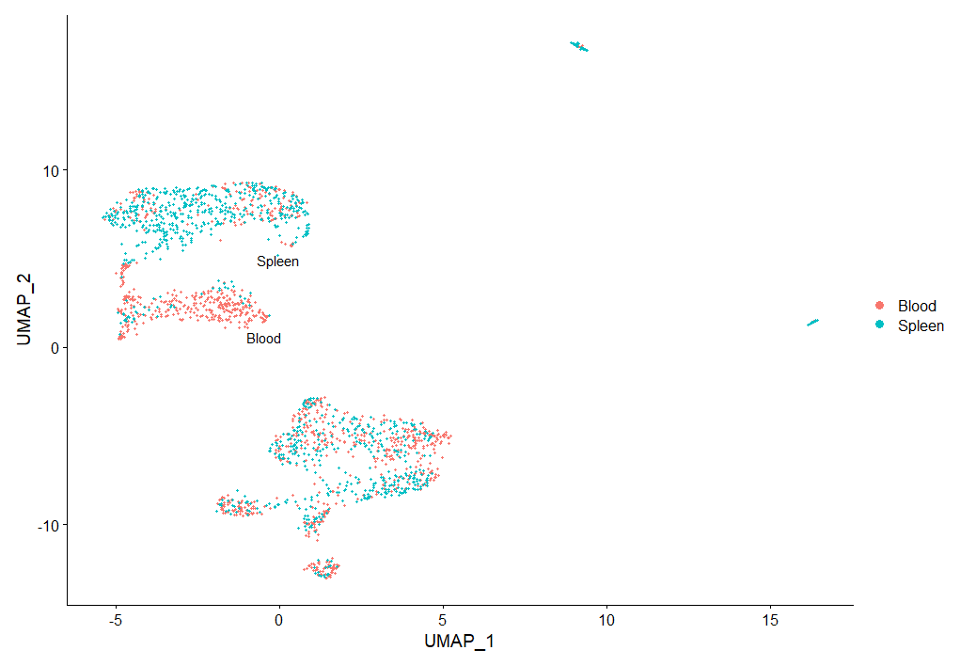
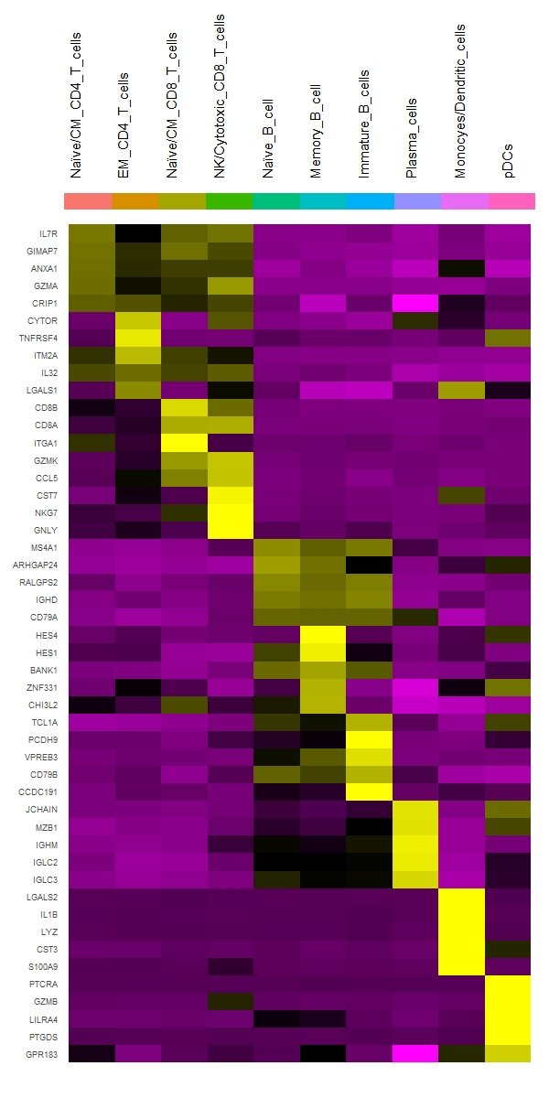
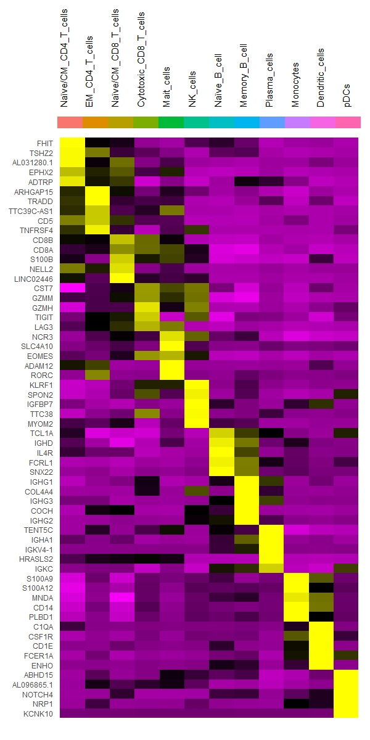
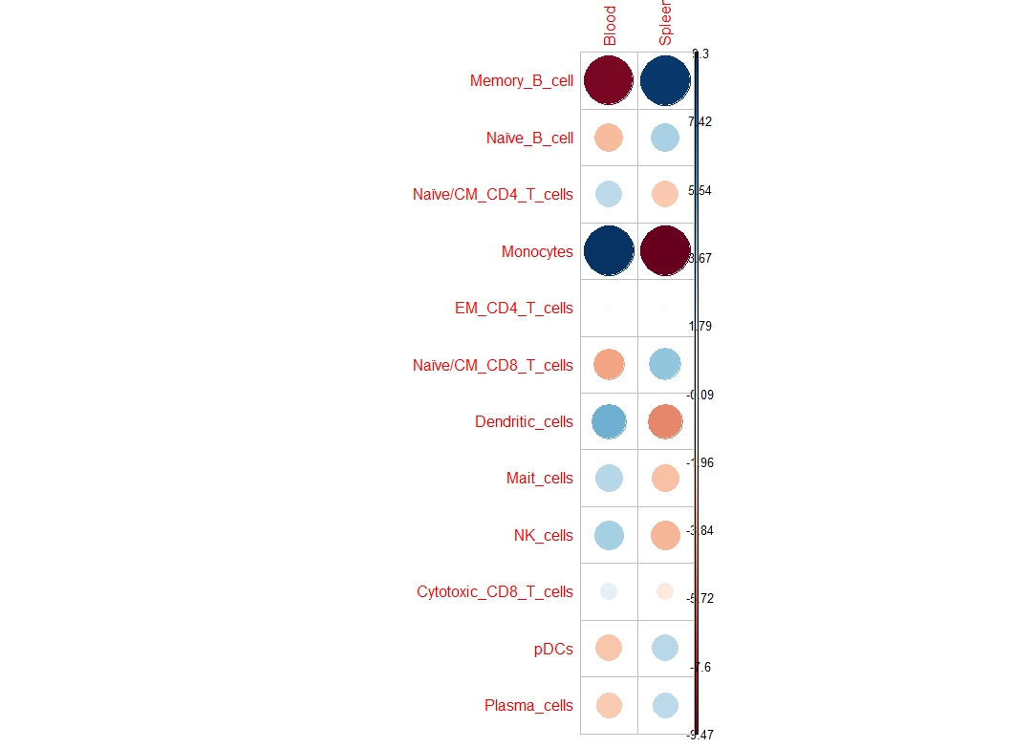
Figure 1
Immune cell atlas of Human Immune System mice.
A
Experimental model
D
B
E
C
F
G
Notes:
Fig 1. Describe model: human immune cells genome wide comparison side by side human blood. (cd45+ human cells) NSG background
B. spleen HIS tumor free → human immune cells
C: heatmap analysis
D: human PBMC (available dataset) and spleen HIS mice
E: blood human vs spleen HIS mice → monocyte from blood human
F: red is down, blue is enriched. Monocytes in human blood. Spleen enriched B cells (functional and non functional B cells)
G: per tissue dividing

Slide 2
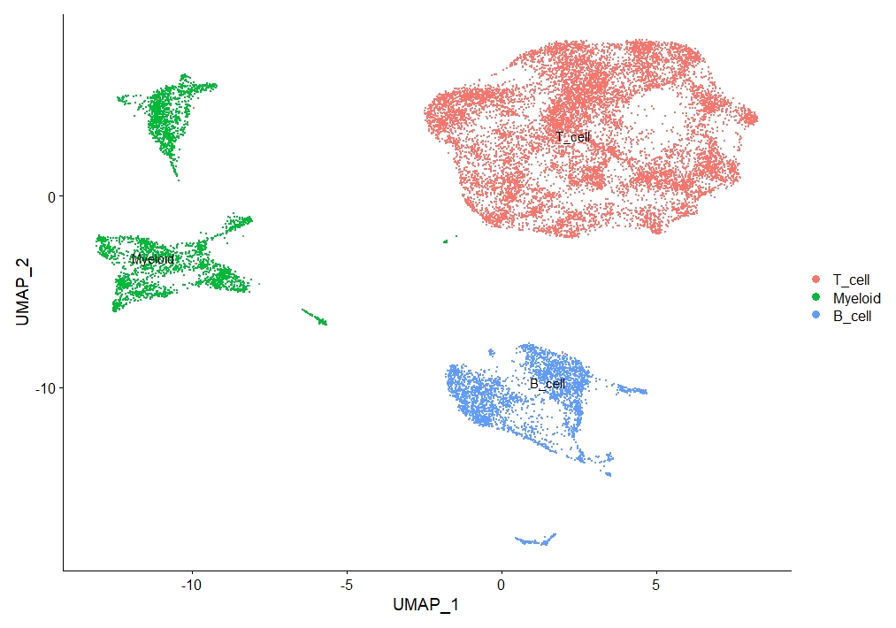
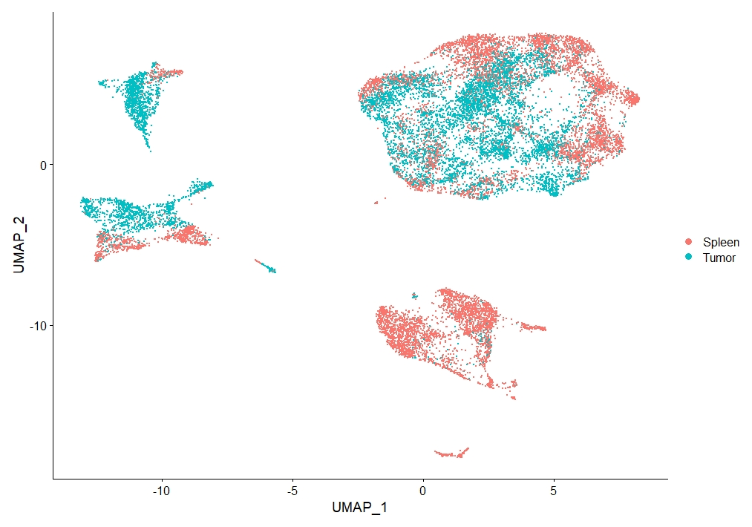
Figure 2
Tumors grown in Human Immune System mice recapitulates Colorectal cancer Consesus Molecular Subtypes
A
Experimental model
B
Tumor growth graphs
C
IHC of the tumors
D
Flow cytometry for CD45+ of tumors
E
F
Spleen<plus tumor_no WT. Show which lineages are enriched in the tumor
Notes:
HIS02.03.all.immune_no_WT
Fig 2. Describtion tumor model
3-4 mice per group (4 groups)
C: IHC of the tumors → number of immune cells is really small. → CONC tumors CD3, CD4, CD8, CD45, CD68, CC19?
D: flow cytomet data is available
E: labelled per tissue: myeoloid, B cells, T cells
F: tumor specific myeoloid development. When infiltrating tumors, myeoloid cells

Slide 3
Figure 3
HIS mice tumors resemble human tumors
A
tSNE human tumors. Maybe compared to normal tissue?
B
tSNE human tumors plus mouse tumors
C
Tsne by tissue or some other graph
D
Heatmap average by tissue
Notes:
Include all tumor cells from HIS1, HIS2 and HIS3
Fig 3. HIS mice tumors resemble human tumors
A: Overlap three patients and his mice? VENI Felipe. HIS mice CMS classification (CMS classification @Kristiaan checks)

Slide 4
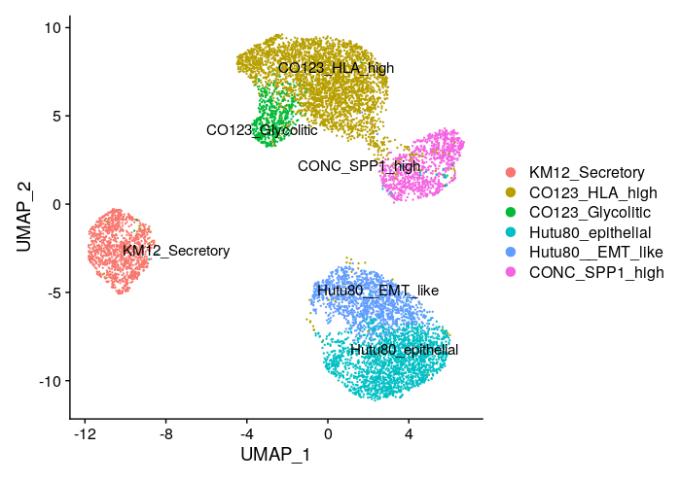
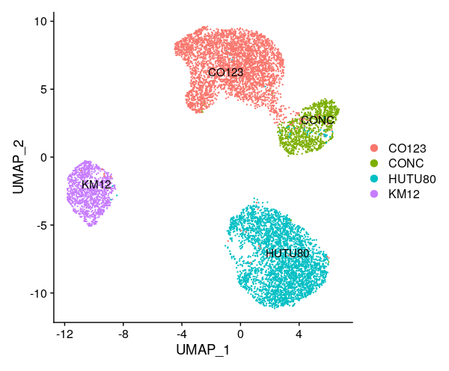
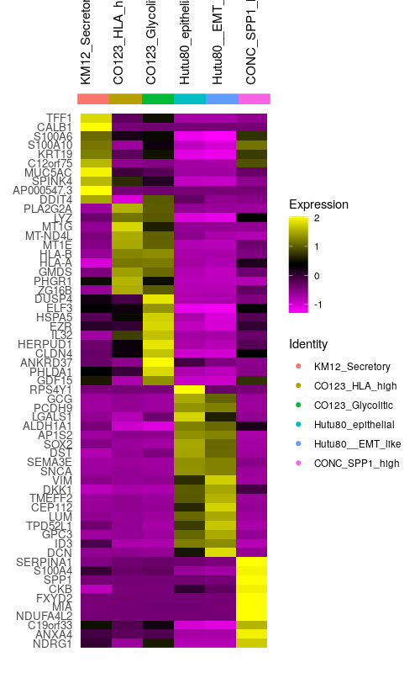
Figure 4
Tumor cell analysis, including the CMS classification from nature genetics approach.
Notes:
Fig 4. Non human immune cells. Stromal cells, tumor cells (human) → DO NOT INCLUDE
Human tumor cells
A: UMAP on tumor cells

Slide 5
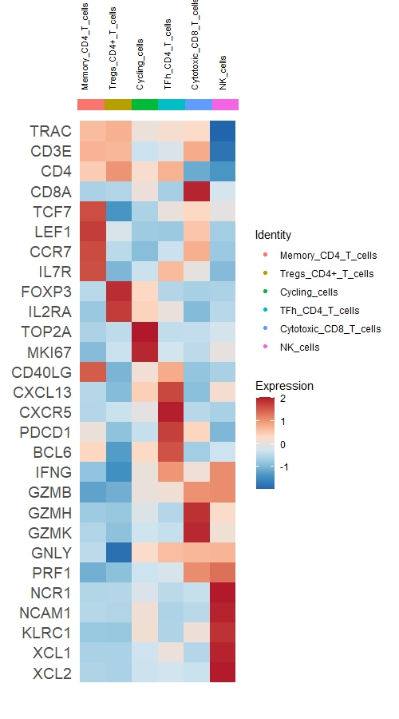
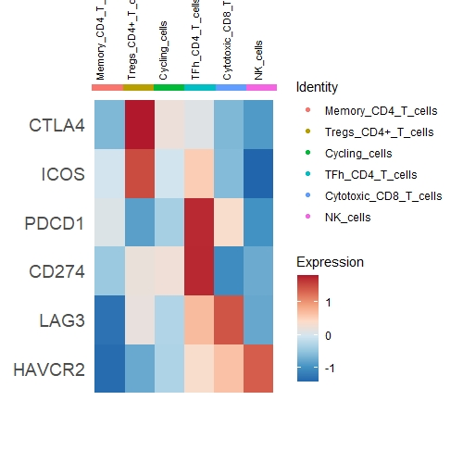
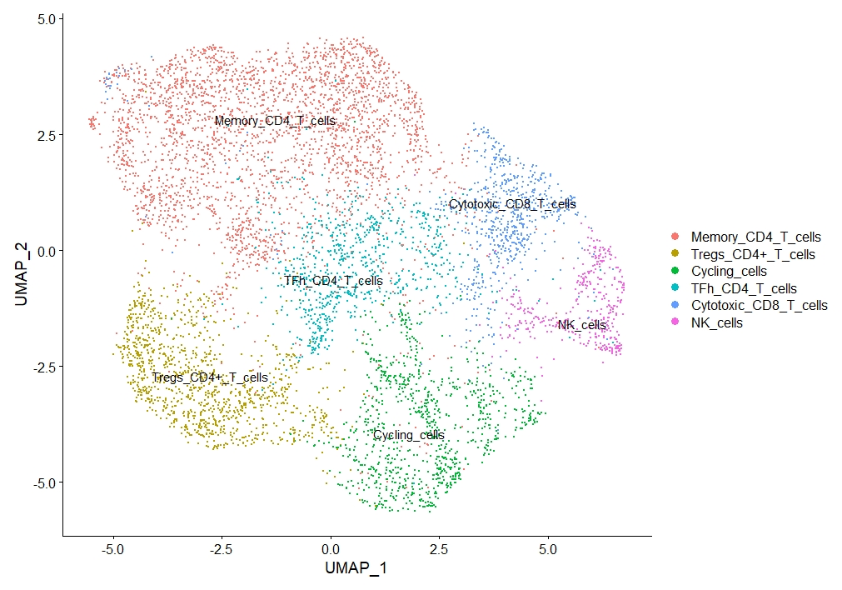
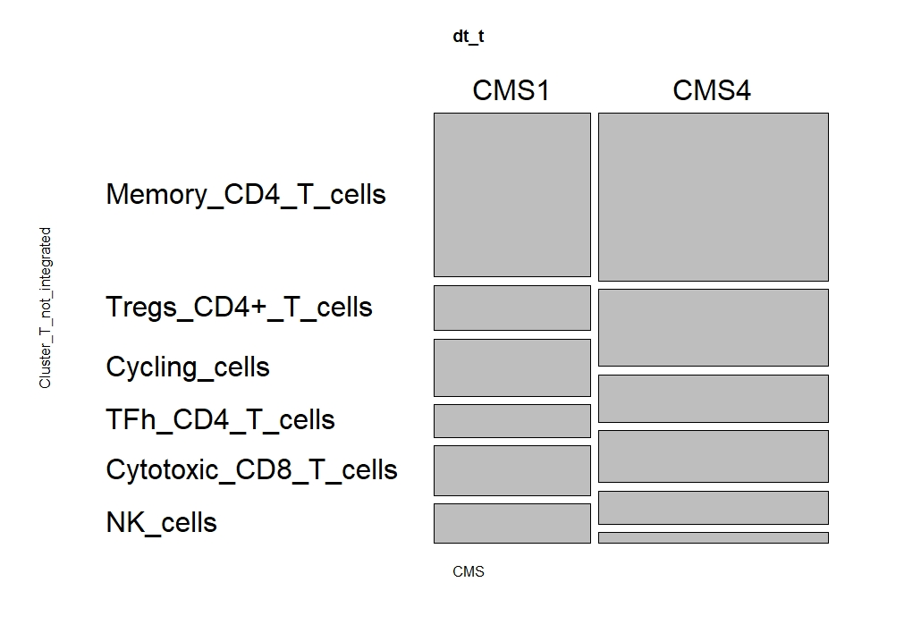
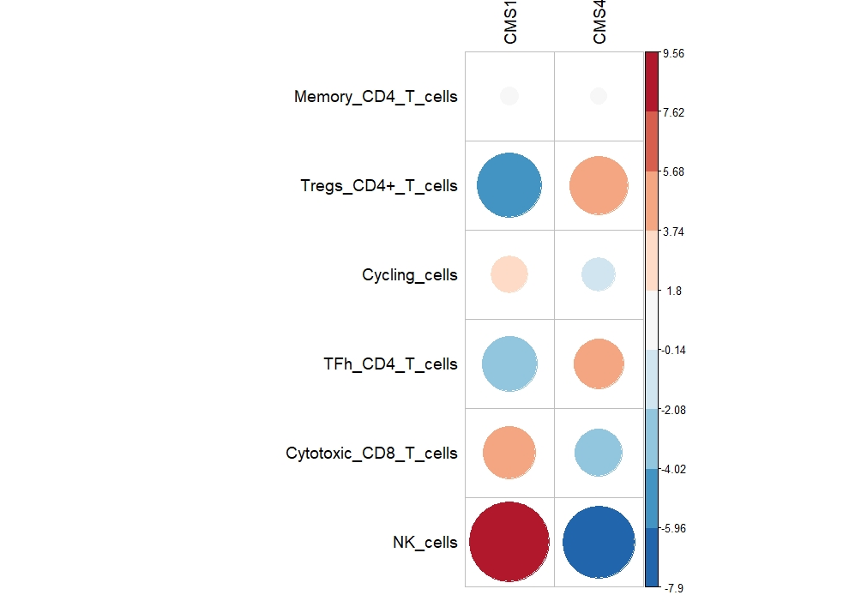
Figure 5
T cell populations enriched in tumor mimics patient molecular features
A
B
C
D
E
F
G
T cells from CMS1 and CMS4 nat genetics
Re-analyse flow cytometry Tregs - supplementary
1 supplementary of division between T, B and T
Description of T cells in tumor. CMS1 x CMS4
Tumor x spleen in supplementary
Notes:
Figure 5 T cell population (HIS mice) mimics tumor patient molecular featrures
A: UMAP T cells tumors (no spleen)
B: classical T cells/B cell markers
C: exchaustion markers tumor HIS mice) → Job: PD-1 high on CD4 (Tfh)!! IHC!! (see paper Sofia tertiary lymphoid structures)
D: T cell pop on CMS1 vs CMS4
E: CMS1 more NK cells
G: CMS1 CMS4 nat genetics paper T cells… same analysis???

Slide 6
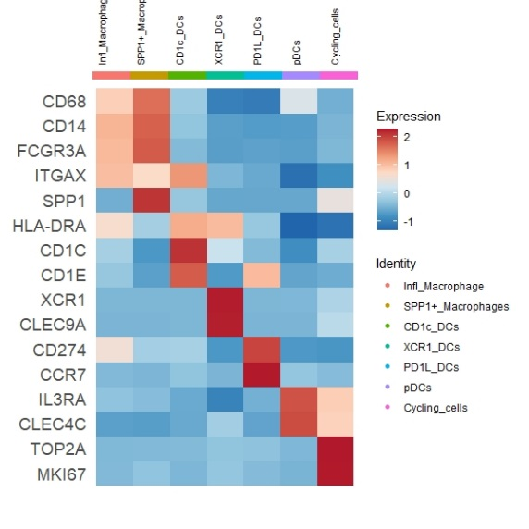
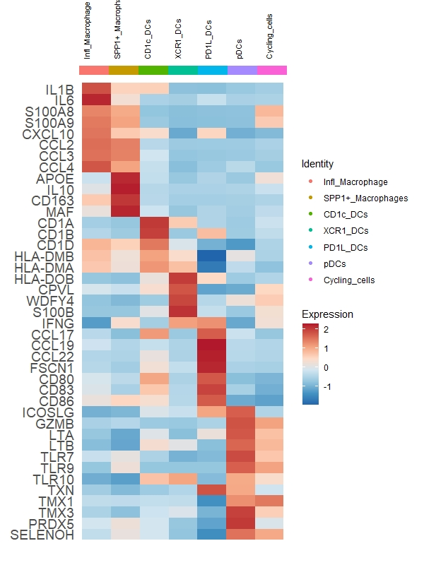
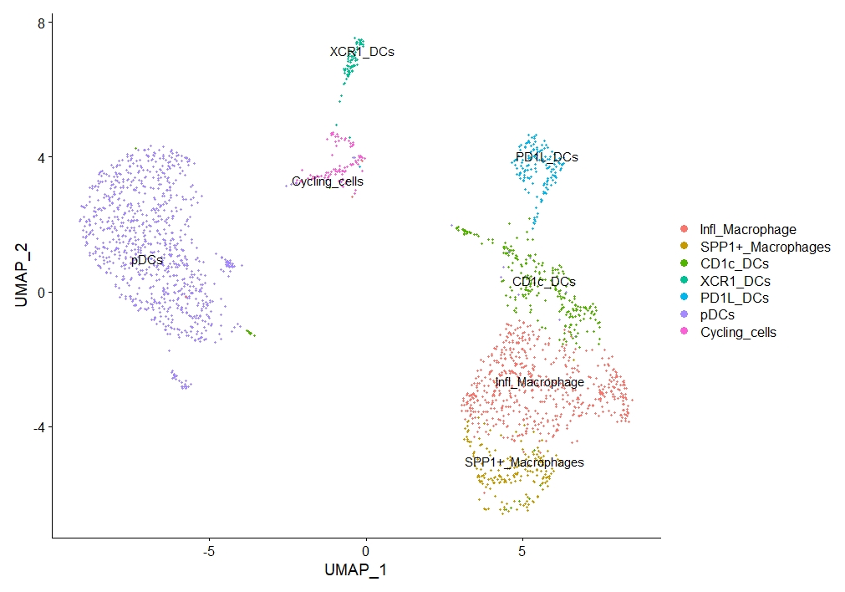
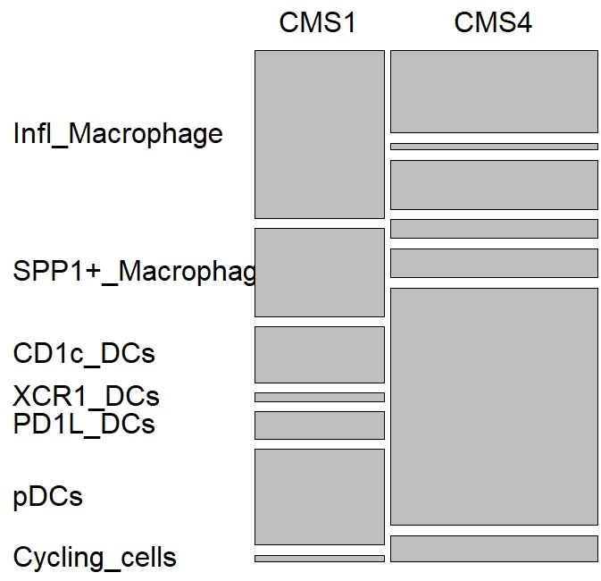
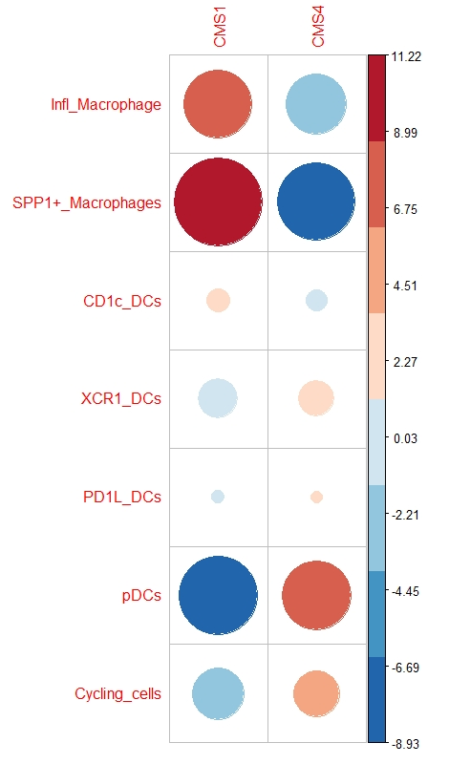
Figure 6
Myeloid
A
B
C
D
E
F
pDCs and DCs subclustering nature genetics
G
pDCs and DCs CMS association in nature genetics
Re-analyse flow cytometry pDCs - supplementary
Tumor x spleen in supplementary
B cells in supplementary.
Notes:
Figure 6. myeoloid cell pop (HIS mice)
A: UMAP. Spp1 macrophages (CMS1 marker???)
B: (non) canonical markers
C: top DEG’s → inflammatrooy macrophages
D: CMS1 feature … spp1+ macrophages
E: same
F:
G:

Slide 7
Figure 7
CellPhoneDB analysis CMS1 vs CMS4
A
Heatmap CMS1
B
Heatmap CMS4
C
D
Interactions in bulk rnaseq
CherryPicked Interactions
E
Interactions in kapplan meyer
Notes:
Fig 7. Interactome CMS1 vs CMS4
Analysis are done by Felipe.

Slide 8
S1
T cell populations enriched in tumor mimics patient molecular features

Slide 9
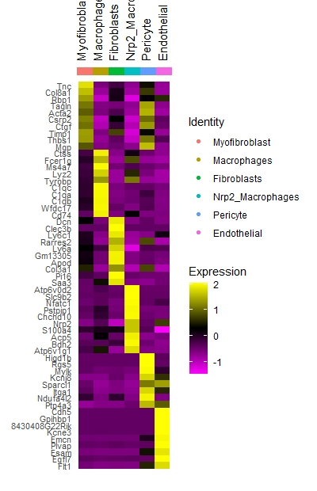
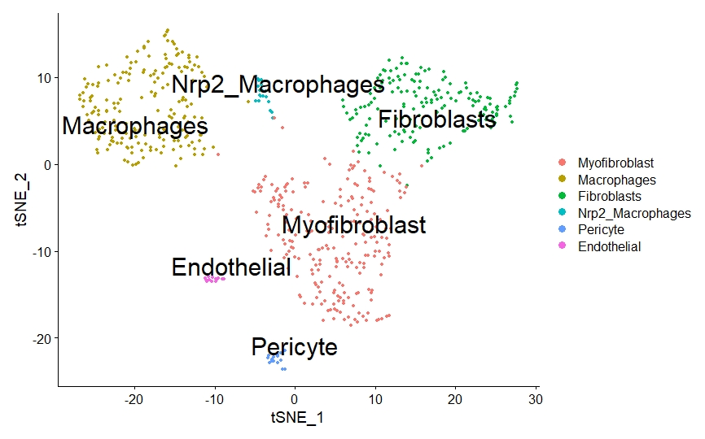
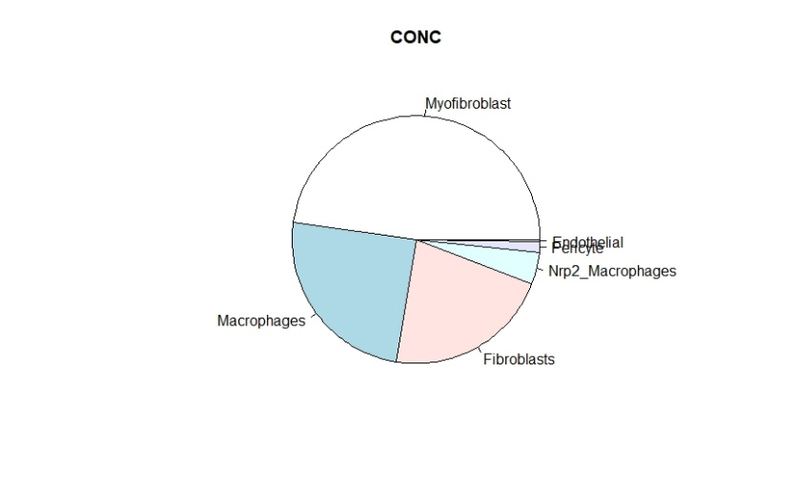
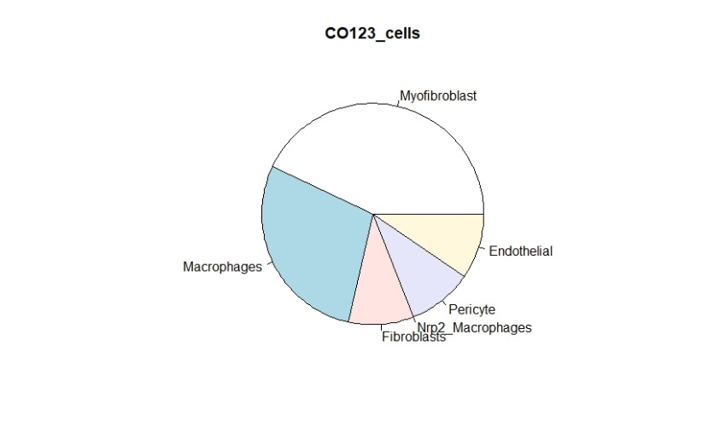
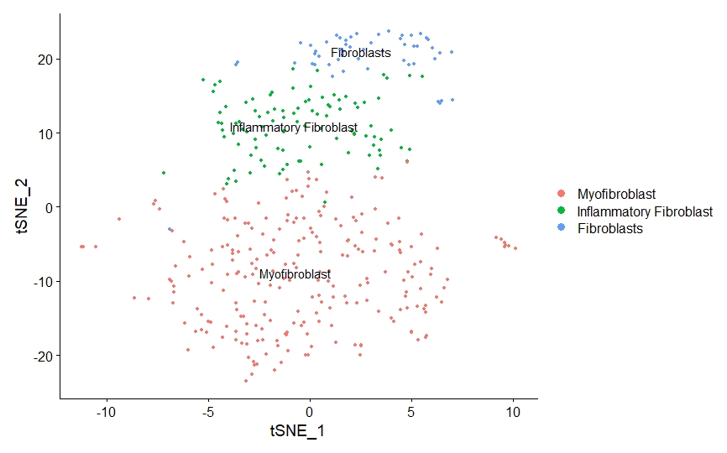
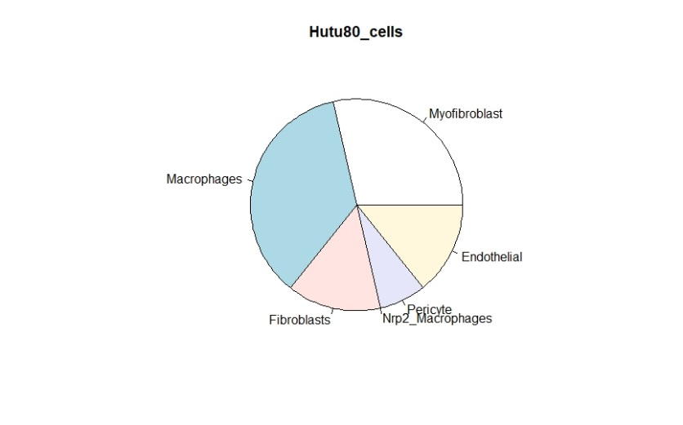
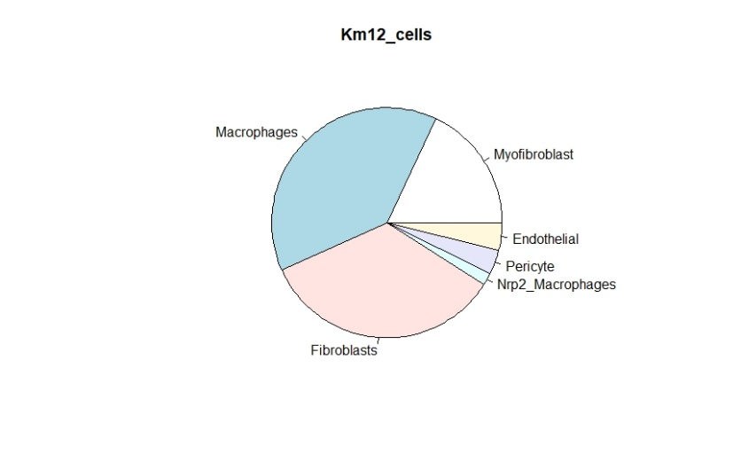
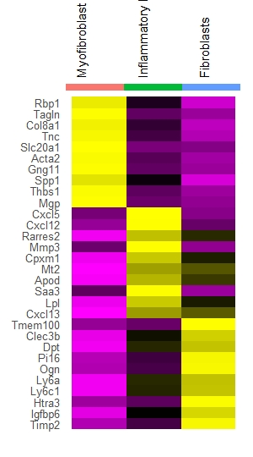
Figure 3
Description of mesenchymal mouse fraction
A
B
C
D
E
F
Microscopy of myofibroblasts vs fibroblasts in HIS mice tumors

Slide 10
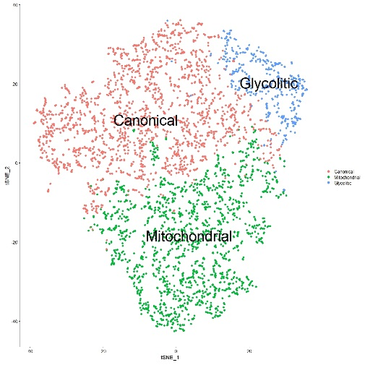
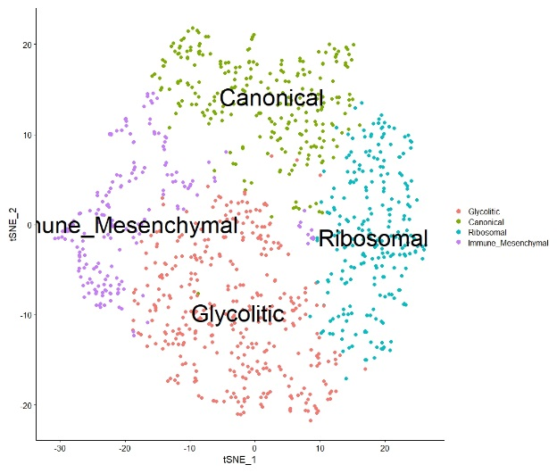
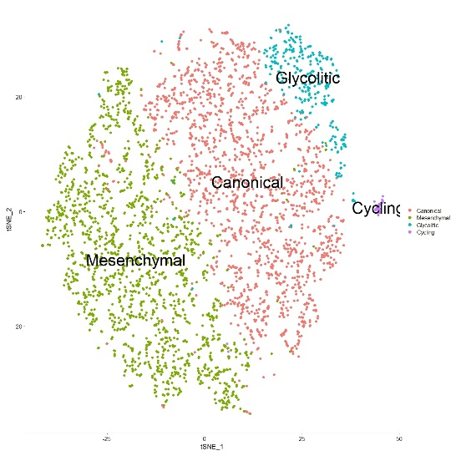
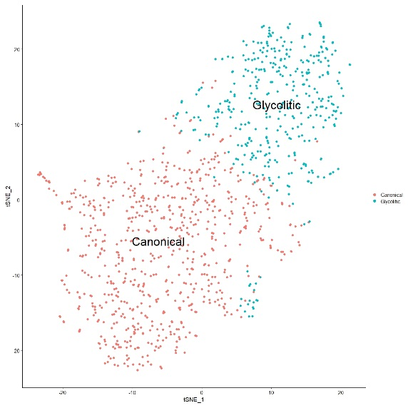
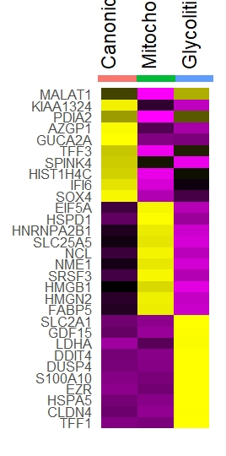
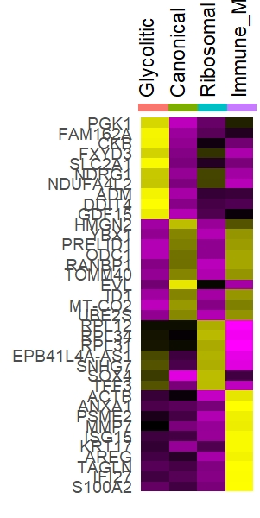
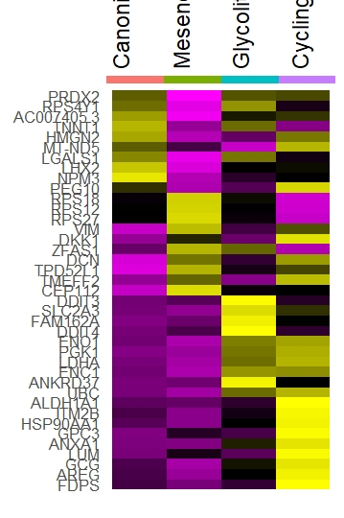
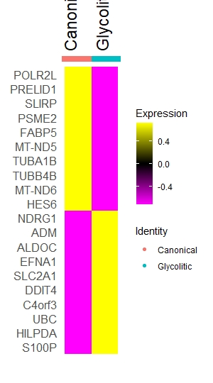
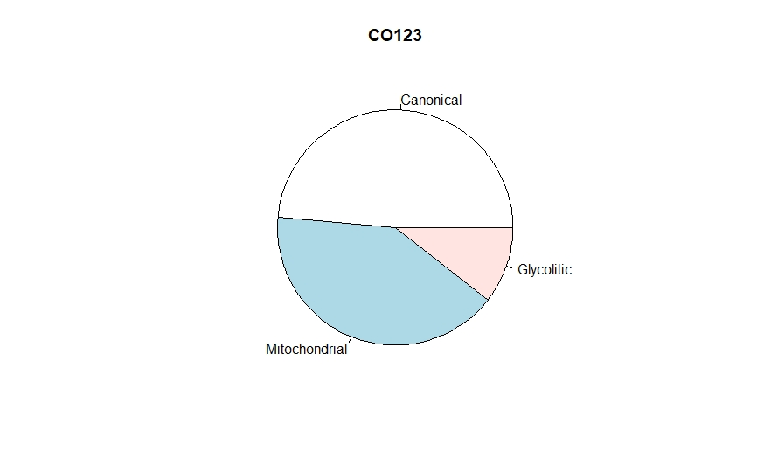
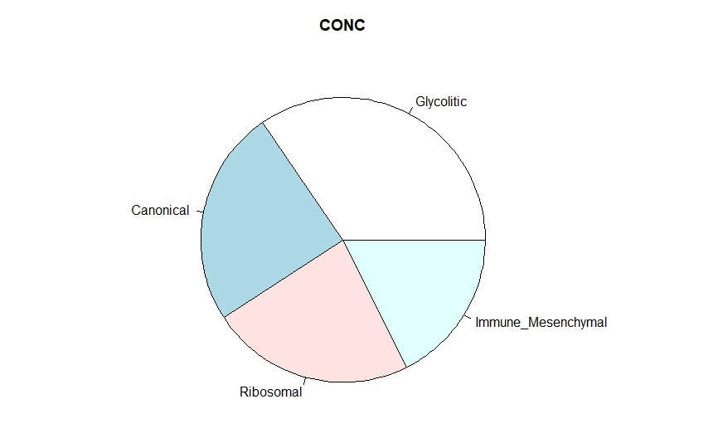
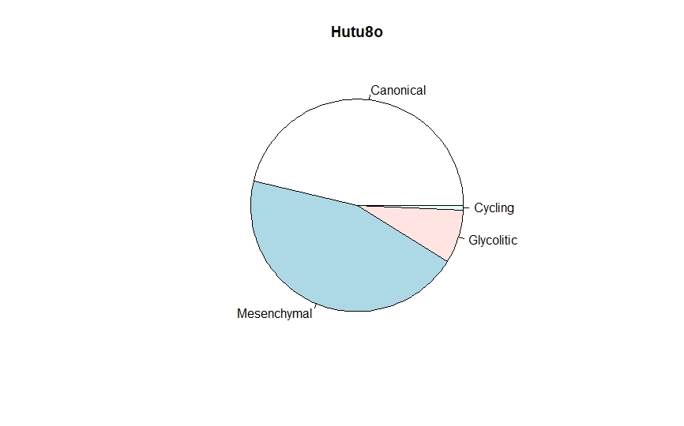
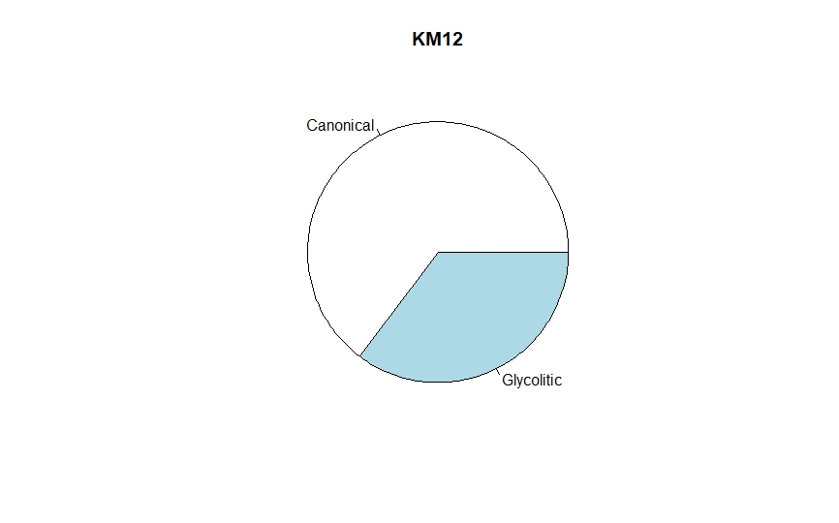
Figure 5
Tumor cell signatures in HIS mice recapitulates human tumor features
A
CO123
CONC
HUTU80
KM12
B
C
E
 | CO123 | KM12 | Hutu80 | CONC
Canonical | CMS3 | CMS2 | CMS4 | CMS2
Mitochondrial | CMS2
Cycling |  |  | CMS2
Mesenchymal |  |  | CMS4
Ribosomal |  |  |  | CMS4
Immune-mesenchymal |  |  |  | CMS1
Glycolytic | CMS4 | CMS4 | CMS4 | CMS3

Slide 11
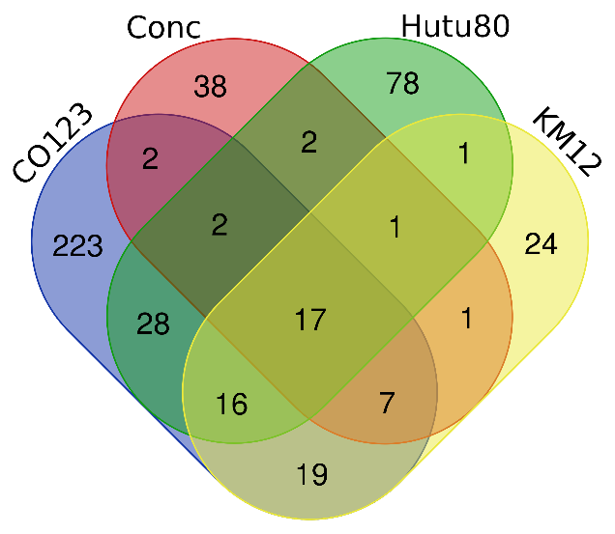
Figure 5
CRC tumor cells adopt a core glycolytic signature that regulates endothelial cell function
A
B
Small tSNE of all markers in one line
Confocal imaging of glycolytic cluster in mouse (Maybe “canonical as well”?)
Confocal imaging of glycolytic cluster in humans (Maybe “canonical as well”?)
C
D
E
Confocal imaging of Adrenomedullin and VEGFA? Or in figure 3
E
Options:
1)ADM and VEGFA in cell culture medium?
2)Purified ADM and VEGFA in endothelial cells, fibroblasts and immune cells?

